Slide 1
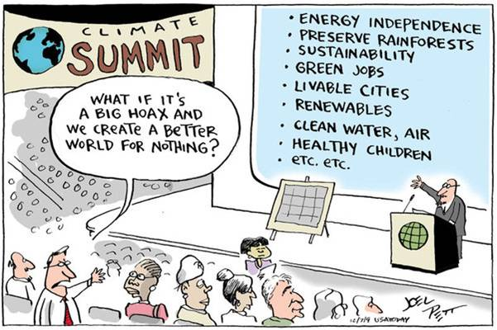
Emergency Response and Recovery

Slide 2
40 Years of Warning (and Warming)
Late 1970’s, initial concerns were raised and grew during the 1980s
The International Panel on Climate Change (IPCC) was established 1988 to investigate and report
Series of Assessment Reports. Five to date since 1990, with the last published in 2014 and the next (AR6) due in 2021/22. Plus other special IPCC reports.
A huge amount of real data, research and modelling

Slide 3
Lots of Meetings and Agreements
United Nations Framework Convention on Climate Change (1992) – stabilise CO² to non-dangerous levels
Kyoto Protocol (1997) – legally binding obligations
UN Climate Change Conference – 2010 – 2ºC limit
Paris Agreement (2015) – 2ºC limit, but pursue efforts to limit warming to 1.5ºC
Conferences of the parties every year since 1995. Glasgow (COP 26) this year

Slide 4
IPCC – Told You So
1990 – “potentially the greatest global environmental challenge facing humankind”
1995 – “Climate change is likely to have wide-ranging and mostly adverse impacts on human health, with significant loss of life”
2001 – “Projected climate changes during the 21st century have the potential to lead to future large-scale and possibly irreversible changes in Earth systems resulting in impacts at continental and global scales”
2007 – “If global average temperatures rise between 1.5C and 2.5C, then "approximately 20 to 30 per cent of plant and animal species assessed so far are likely to be at increased risk of extinction”.
2014 – All of the above plus more
The science is good and evidence overwhelming
So what has the reaction been to three decades of warnings?
Since 1990 annual global greenhouse emissions have gone up by 57%

Slide 5
UK – Doing Fine (?)
UK Climate Change Act 2008 – legally binding target to reduce greenhouse gas emissions by 80% compared to 1990 levels
5 year carbon budgets (with targets) – set statutory limits on emissions
First two budgets met and in 2018 UK had reduced carbon emissions by 44% compared to 1990 levels
No adverse effect on economic growth
But –this reduction has been very uneven

Slide 7
But Not Really
Not on track to meet the 3rd and 4th carbon budgets (51% cut by 2025 and 57% by 2030)
Our scientific understanding of the risks of climate change has altered since UK Climate Change Act of 2008
The adverse effects of a 1ºC warming are already evident
IPCC 2018 special report concluded that limiting global warming to 2ºC was not enough and that the limit should be 1.5ºC
Based on the findings of the IPCC special report a new emissions target of net-zero was recommended to the UK Government by the Committee on Climate Change (CCC)
Parliament declared a climate emergency on 1st May 2019
The net-zero target was enshrined in law in June 2019

Slide 8
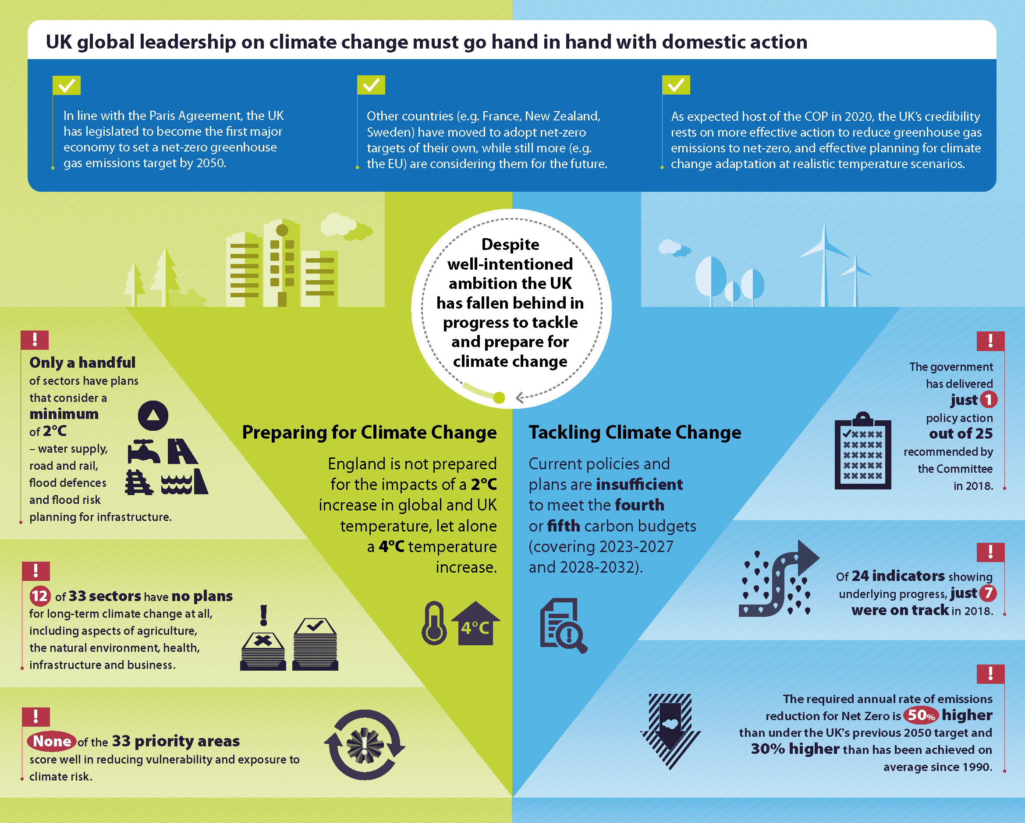

Slide 9
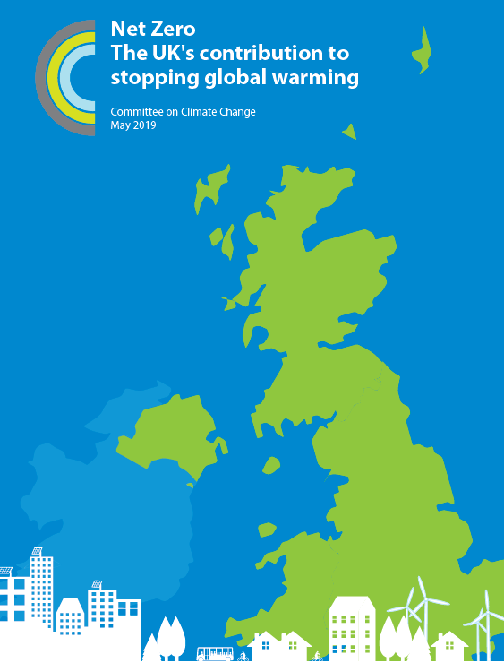
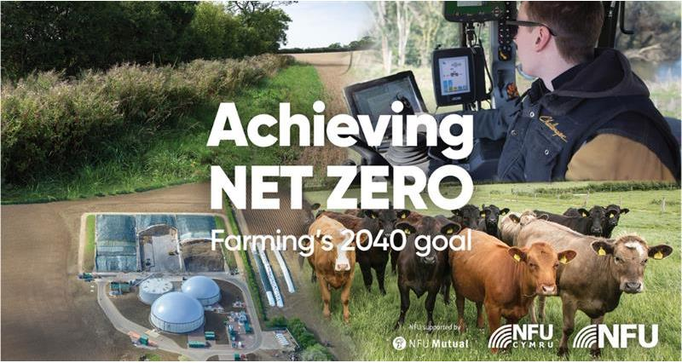
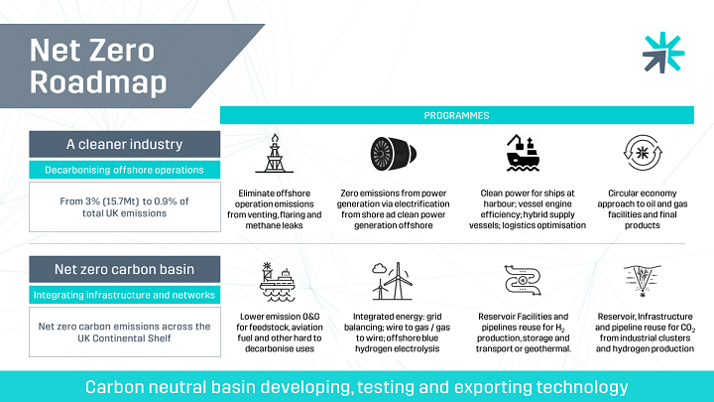
What does net-zero mean?

Slide 10
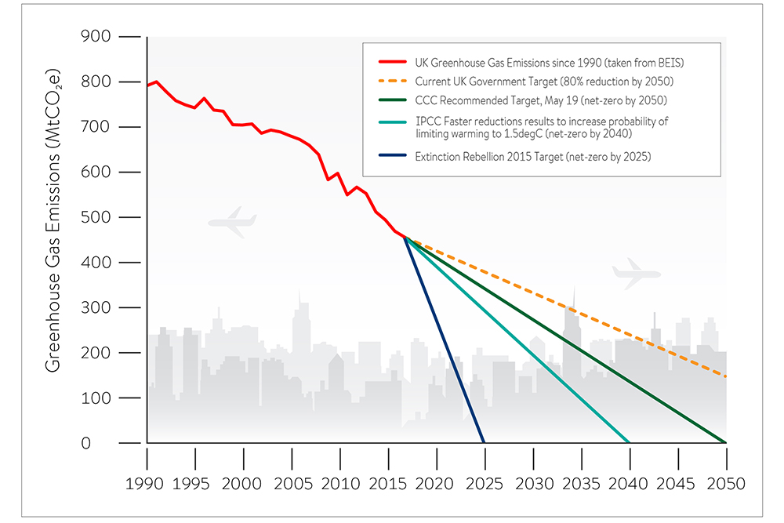
What does net-zero mean?

Slide 11
What does net-zero mean?
The new legislation requires that the UK bring all greenhouse gas emissions (CO₂, methane, nitrous oxide and hydroflurocarbons) to net zero by 2050
Extensive change (transformation) across all sectors of the economy and public life will be required
Zero greenhouse gas emissions unlikely to be achievable from some sectors, so offsetting through carbon take-up (e.g. tree planting, carbon capture and storage) will be required
The target is achievable with known technologies and changes to our lifestyles
The economic cost (1-2% of GDP) is the same as that already agreed by Parliament for the original 2008 emissions target
Existing policies are inadequate (even for the current target) and new, clear and well-designed policies are required – immediately

Slide 12
Electricity
In 1990 coal and oil accounted for nearly 80% of UK electricity generation
In the third quarter of 2019 renewable energy provided 39% of UK electricity needs
To meet net-Zero will require that nearly all electricity is produced by renewables (and possibly gas with carbon capture and storage)
Scaling renewables will need new both large-scale solutions (e.g. inter-connectors) but also lots of opportunities for micro-generation (e.g. household solar and storage via a battery)
Use of smart appliances – reducing consumption during peak times
75% of electricity generation should be from low carbon sources by 2030

Slide 13
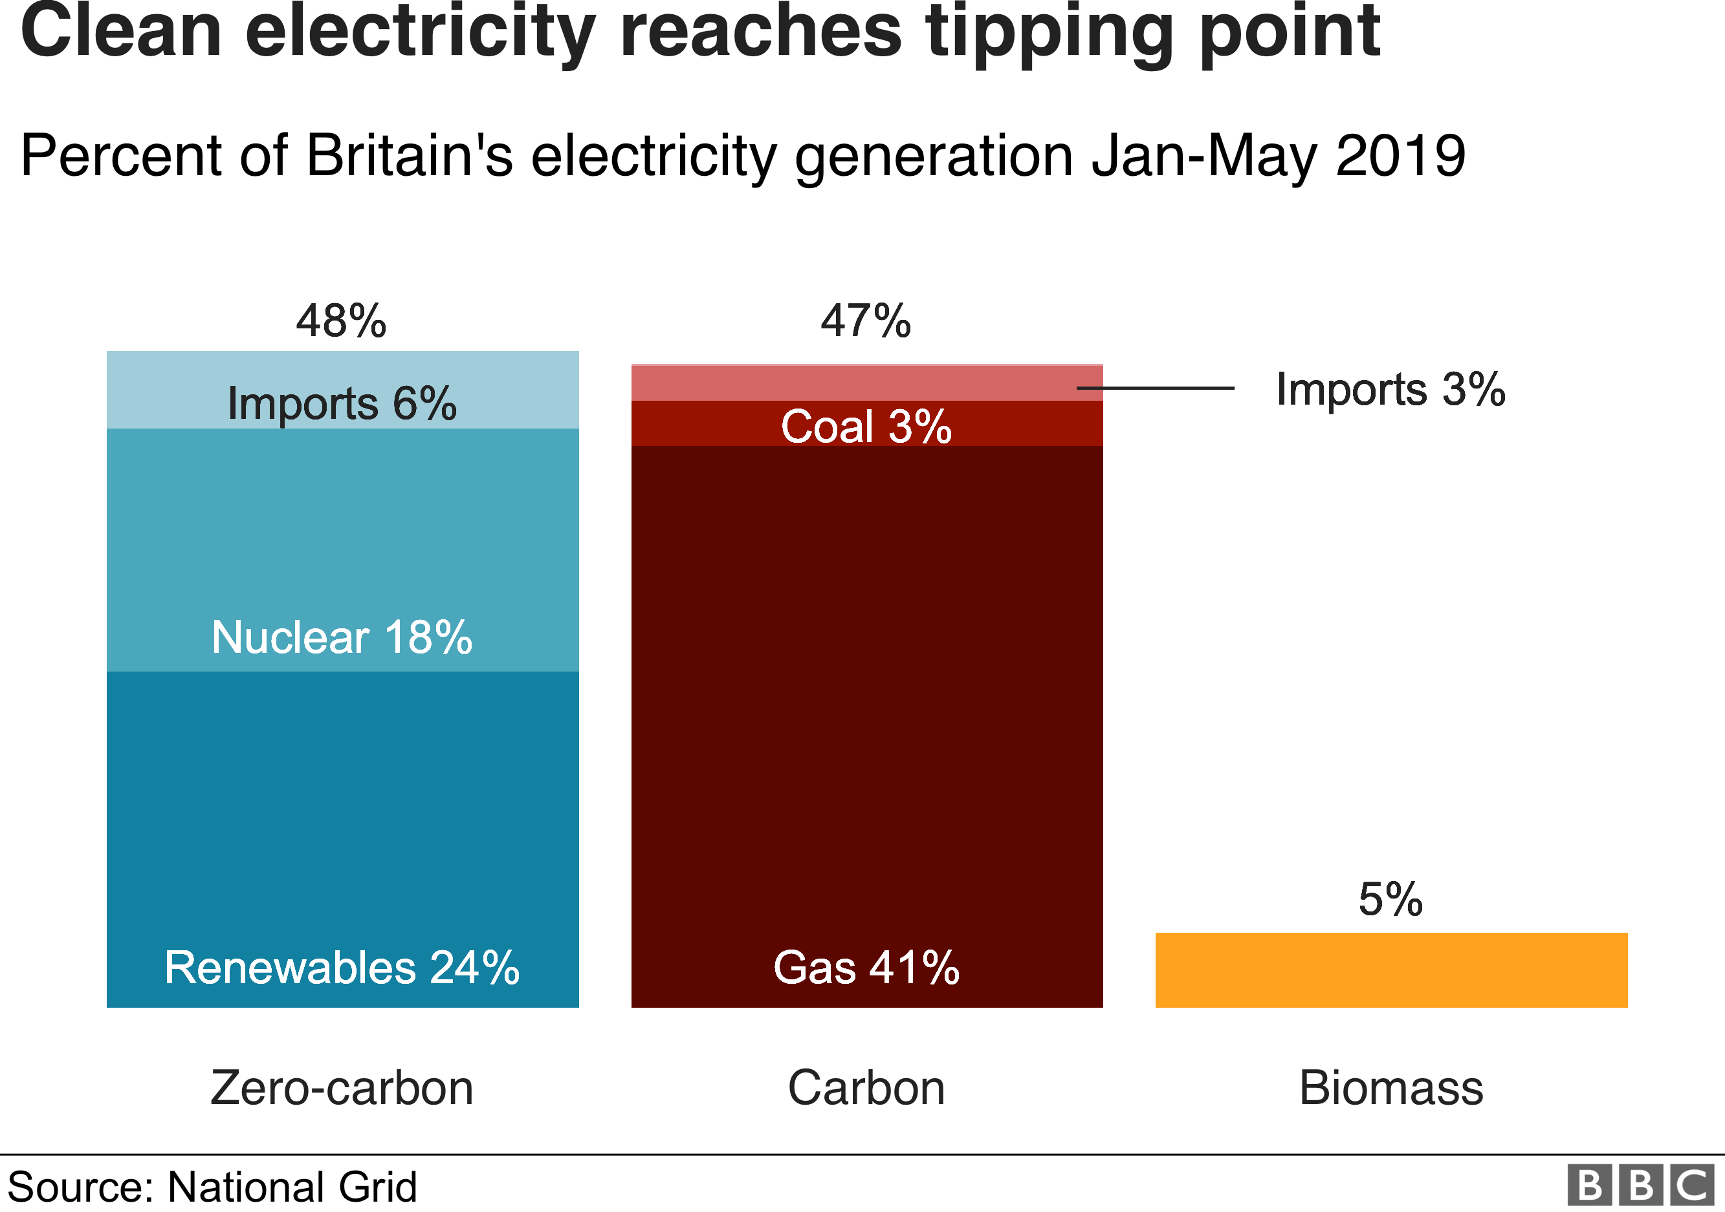

Slide 14
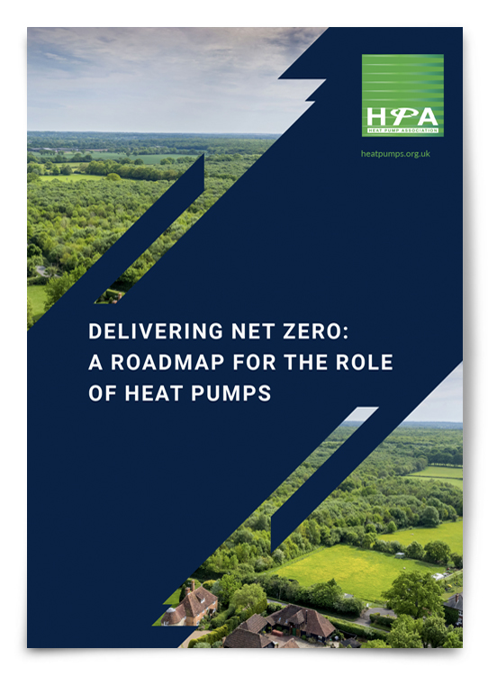
Heating
Solutions that are as good or better than the system we have now
Reduce heat loss – insulation, draught proofing, new windows
Alternative heating systems – move away from gas / oil to electric heat pumps, district heating and hydrogen
Smart control systems – efficient household use of energy
Combination of local / strategic planning and household decisions
To reach net-zero would require the elimination of gas and oil central heating

Slide 15
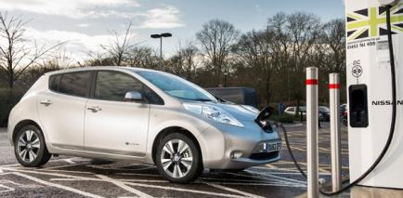
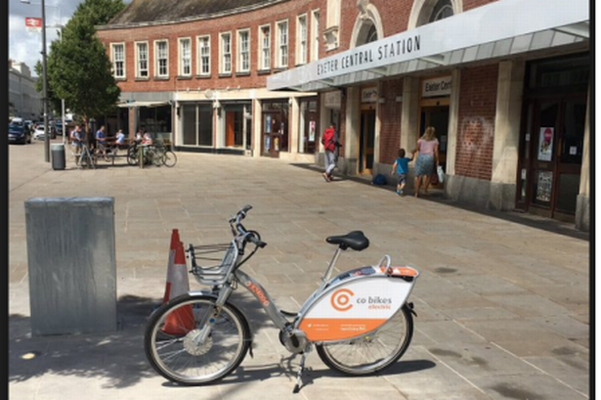
Transport
Significant changes to how we move around will be required
Reduce distance travelled
Shift to more sustainable forms of transport – cycling, walking, public transport
More efficient use of vehicles e.g. car-sharing
New vehicle technology – electric cars. More than sufficient for average trip distance of 13-18km and range (240km) enables weekend trips
But will require charging-point infrastructure (e.g. public charging points for on-street parking)
To achieve net zero all cars will have to be fully electric (or hydrogen) by 2050. All new car sales from 2035 will have to be electric.

Slide 16
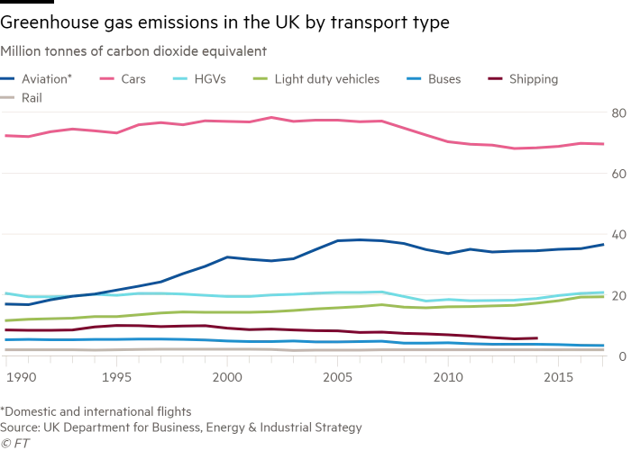

Slide 17
Aviation
Household emissions from recreational flights have almost doubled since 1990
But, 15% of people were responsible for 70% of all flights in 2014
Aviation industry forecasts 70% more flights by 2050 and that net-zero can be reached
However, low-carbon alternatives for passenger flights are technically challenging
Better flight efficiency and management; use of biofuels and advanced technologies; manage demand (e.g. use of long-distance trains)
Net-zero would require a reduction in the number of journeys compared to today
However, there would still be significant emissions associated with aviation that would require offsetting

Slide 18
Landuse
In the UK 77% of land is under agricultural production (60% is used for livestock) – 9% of UK greenhouse gas emissions
Net-zero would require significant cuts in emissions from agriculture
20% of agricultural land in the UK would need to move over to carbon storage (trees, soil restoration, re-wildling)
Reduce food waste – around 10 million tonnes of food that leaves farms is wasted (14% of our weekly food shop goes in the bin)
Reduce meat and dairy consumption - CCC recommends 20%
Current levels of food production per capita could be maintained
Re-purpose subsidies to support environmental and climate-friendly farming practices

Slide 19
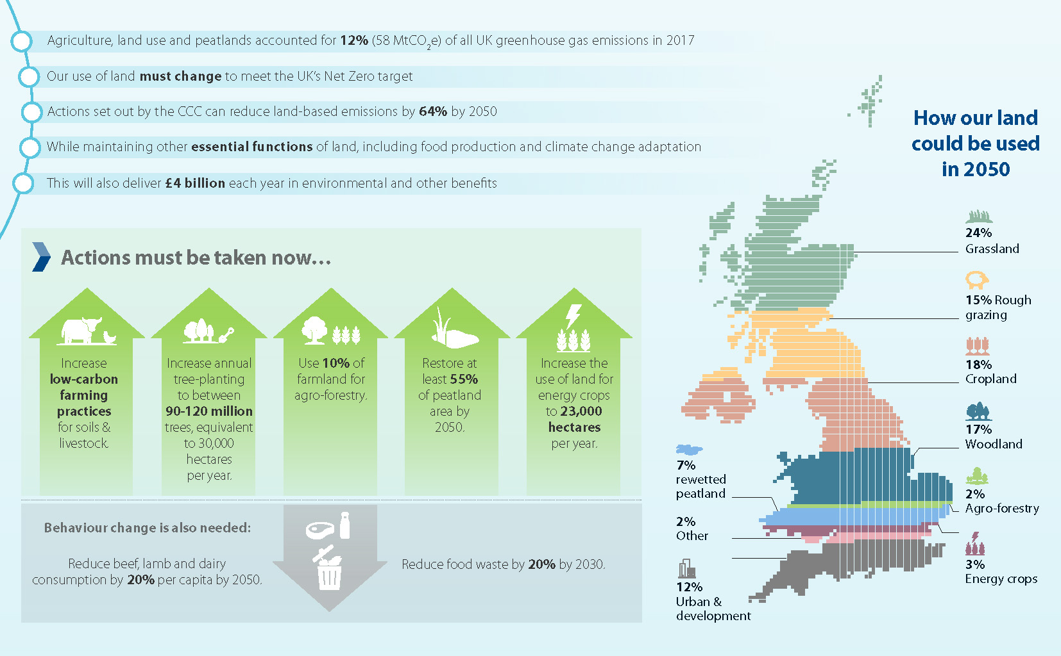
Diet and Agriculture

Slide 20
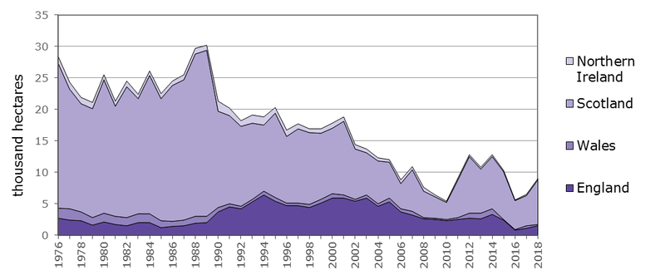
Woodland Planting

Slide 21
Waste
70% reduction in emissions from biodegradable waste since 1990.
Taking this further will require reduction in household waste (e.g. better planning, storage and consumption)
An increase in composting, food waste collection and energy production (anaerobic digestion)
Reduce, reuse and recycle – less consumption
Energy from waste and carbon capture and storage
Reaching net-zero – ban on biodegradable waste going to landfill coupled with household actions

Slide 22
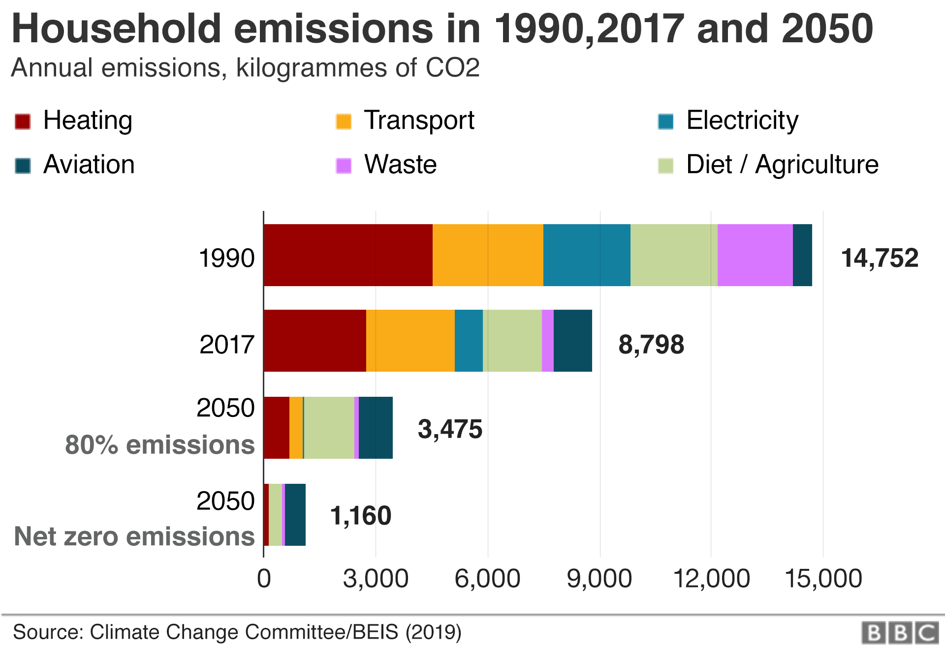
The Average Household

Slide 23
So, what to do?
Switch to a renewable electricity supplier
Install a Smart Meter
Consider alternative forms of heating, check insulation, heat less
Reduce, repair, recycle – more considered and less consumption.
Eat a more plant-based diet
Cycle / walk more. Drive and fly less
Plant trees / let the grass grow / re-wild part of your garden or community spaces
Learn, lobby, communicate, partake
Support others who are doing and making these choices – the benefits are for all

Slide 24
So, what to do?
TAKE ACTION
DO SOMETHING
DO IT NOW
REPEAT

